Slide 1

A Data Scientists Approach to Maximizing Returns in Technical Analysis Investment Strategies
Mid-Semester Presentation of Findings
Benjamin Nicholson

Slide 2
Types of Investment Strategies
Fundamental Analysis
Technical Analysis

Slide 3
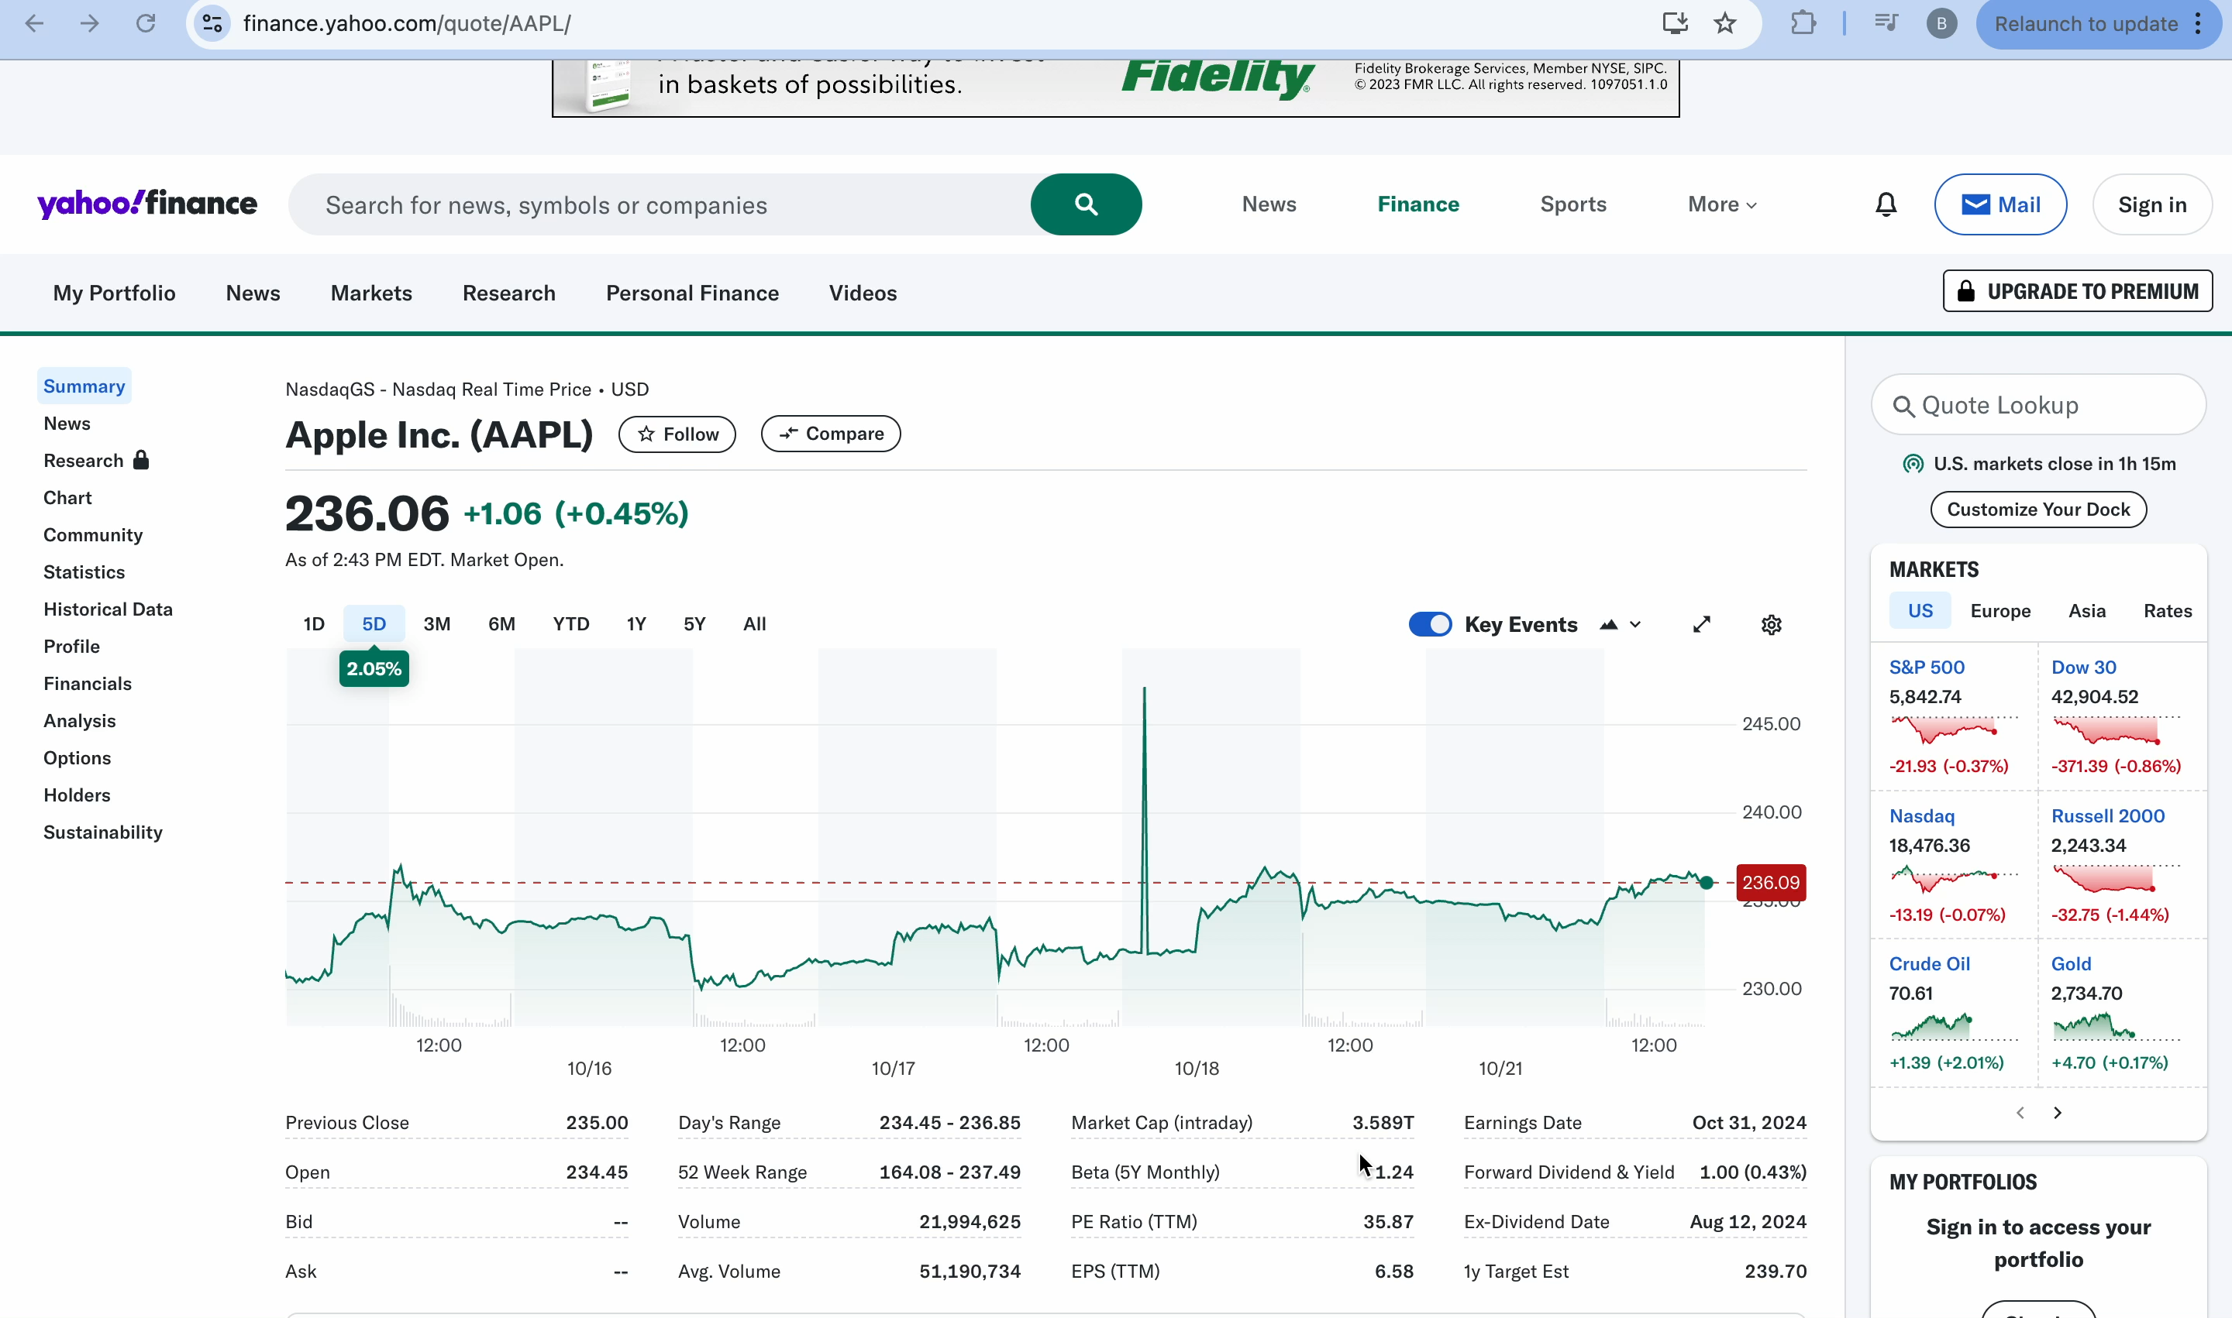
Data Sources
Yfinance

Slide 4
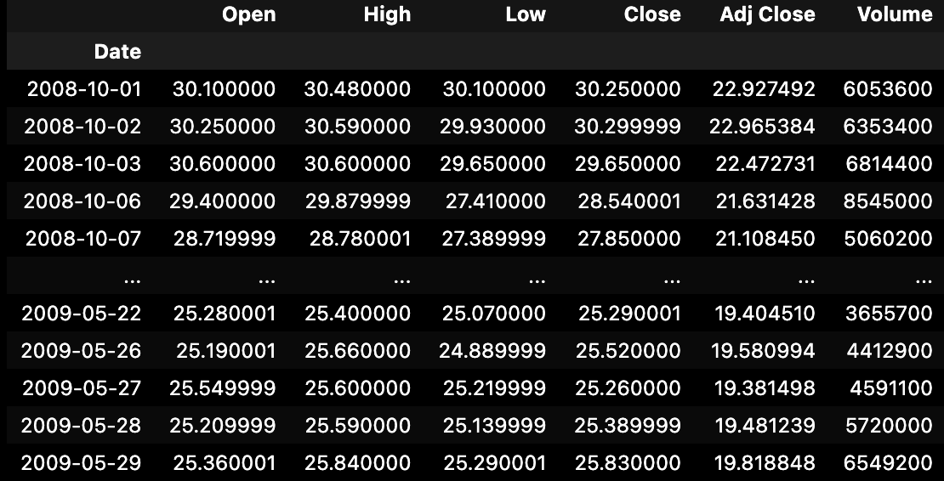
Stock data for ‘XLV’ Healthcare Sector
During a trough time period (2008-10-01 => 2009-05-29)

Slide 5
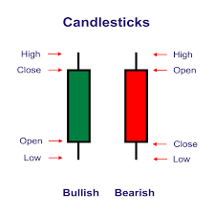
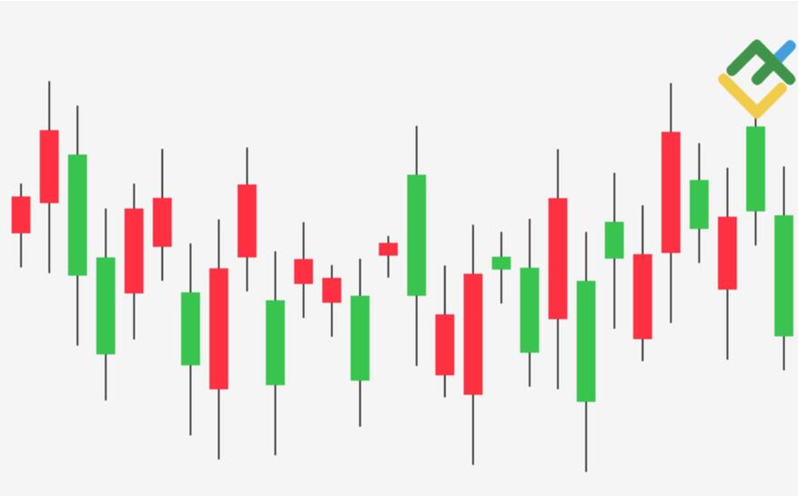
Candlestick Data

Slide 6

The strategy
Evaluate the performance of different technical analysis strategies based on historical ROI.
But how?

Slide 7
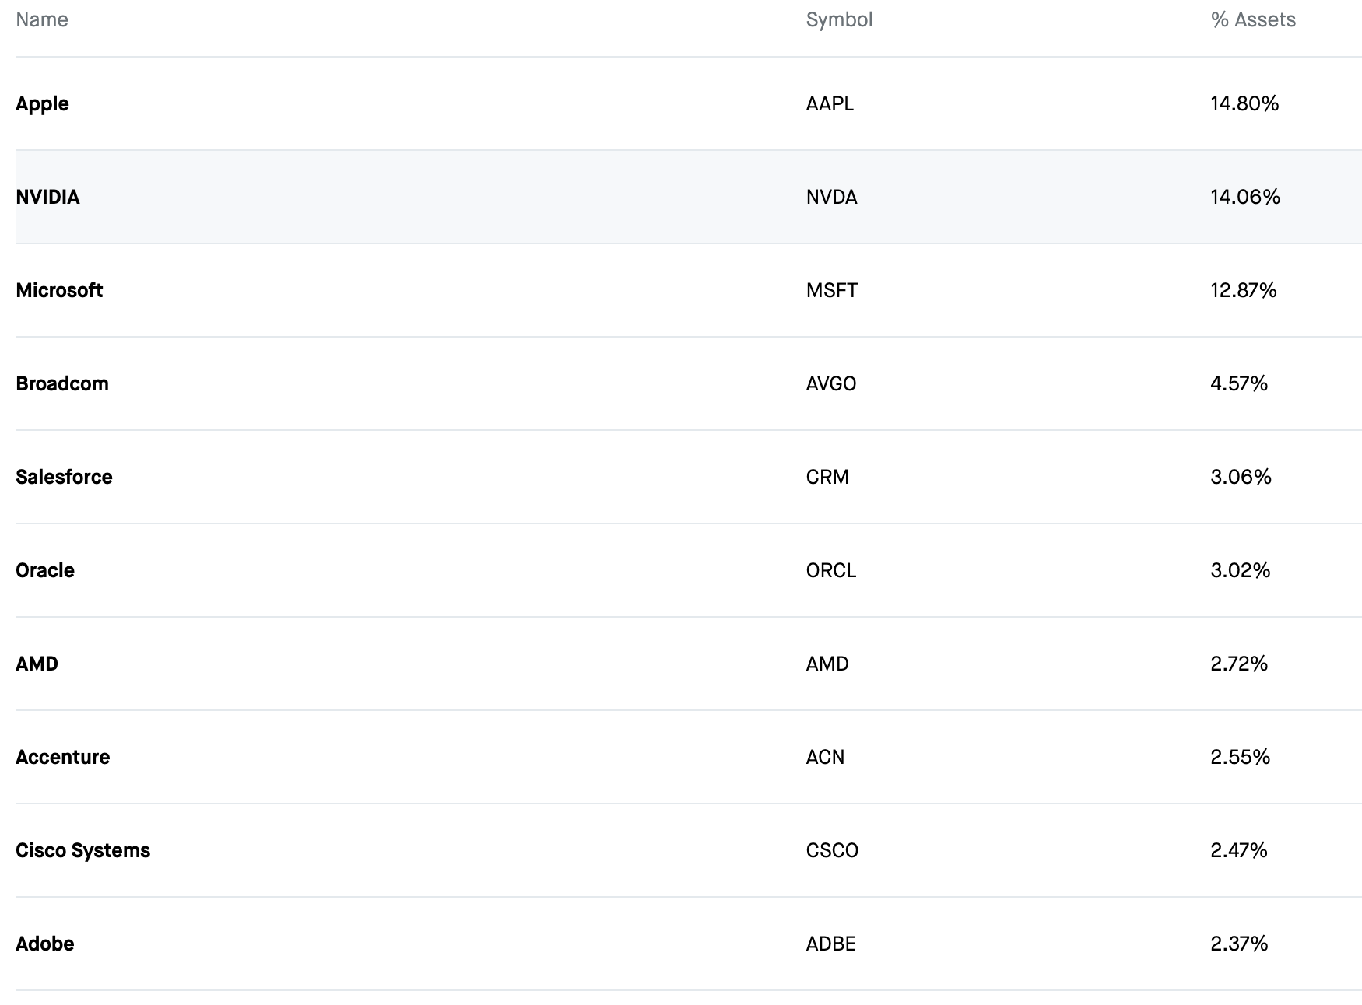
Exchange Traded Funds

Slide 8

Sector ETFs

Slide 9
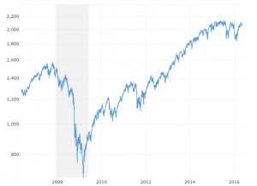
Business Cycle

Slide 10
The strategy (again)
Evaluate the performance of different technical analysis strategies across different macroeconomic cycles, utilizing sector ETFs to mitigate overfitting of models.
Run stochastic models of strategies to get distribution of returns to find expected return.

Slide 11
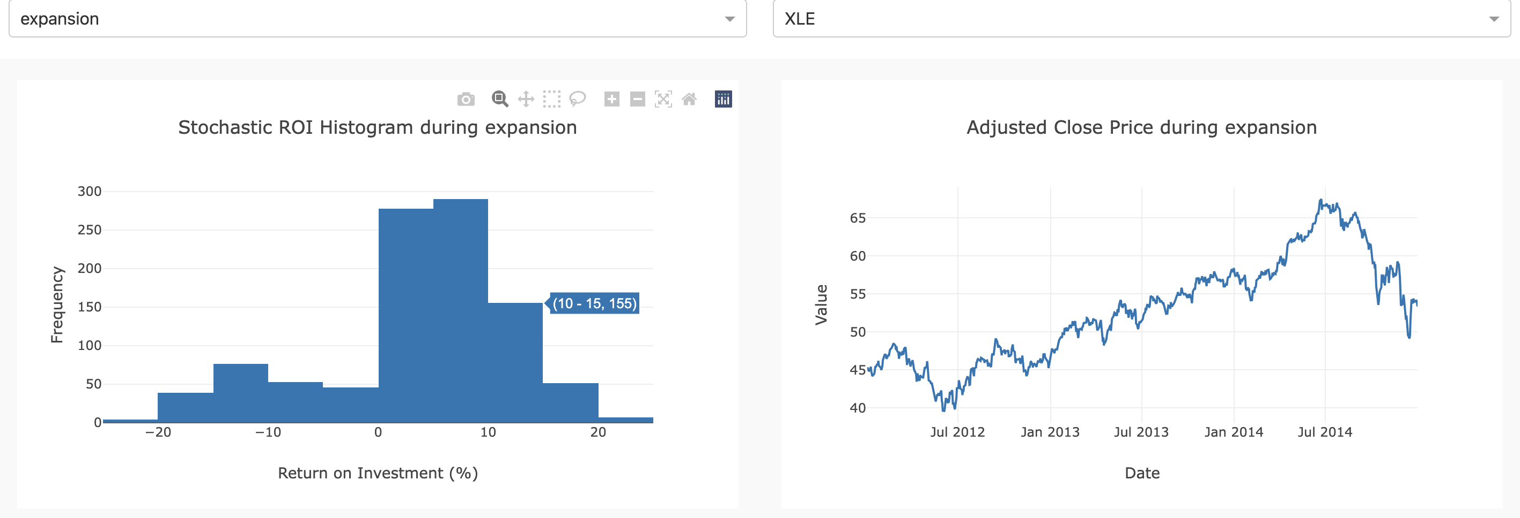
Baseline Model: Buy and Hold

Slide 12
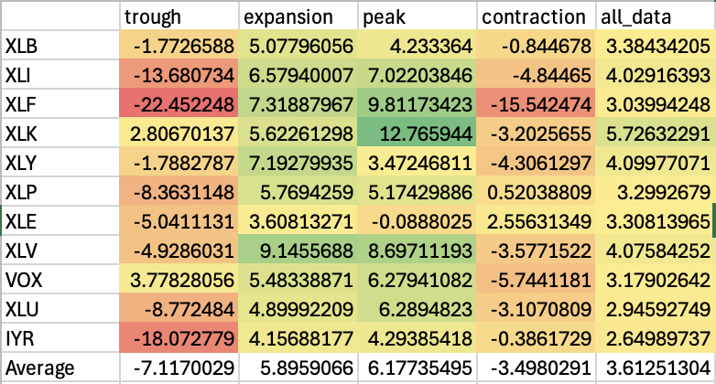

Slide 13
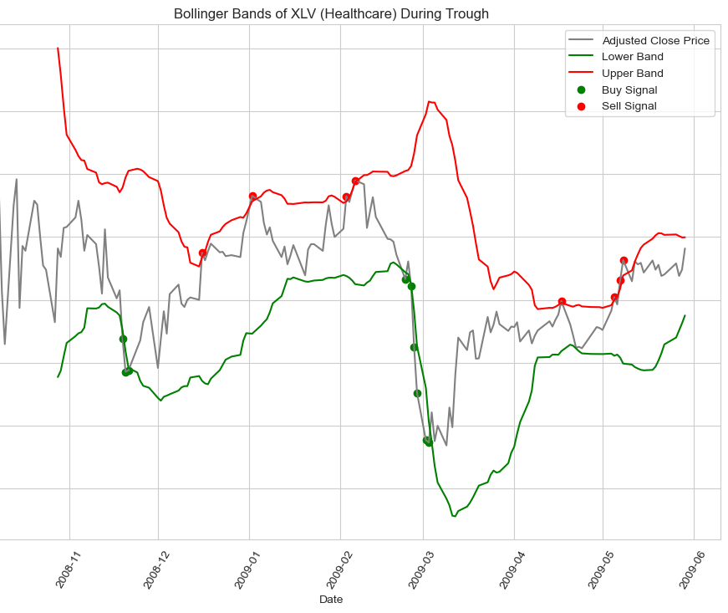
Bollinger Bands: Baseline Model Rolling Average: 20 Confidence Interval: 0.95

Slide 14
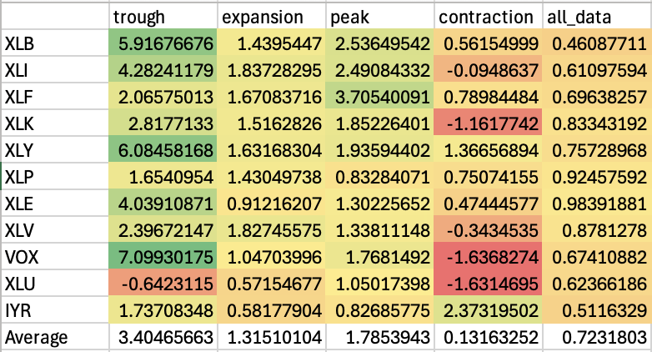

Slide 15
Bollinger Band: Grid Search Optimized Model
Rolling average: 10,15,20,25,30
Confidence Interval: 0.85,0.90,0.95

Slide 16
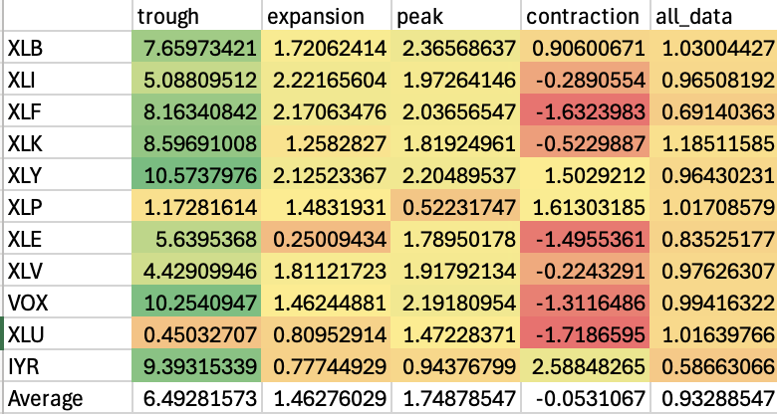
Confidence interval: 0.90 Rolling average: 30

Slide 17
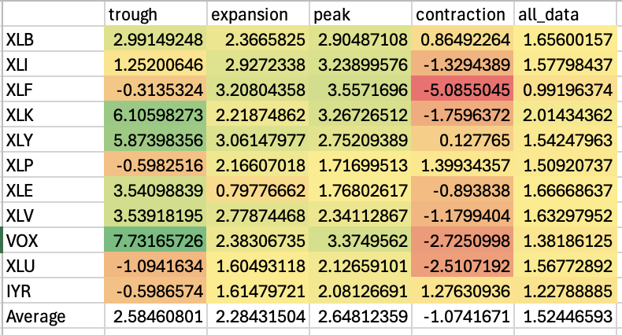
Buy and Hold & Bollinger Bands Model Confidence interval 0.90 Rolling average 30

Slide 18
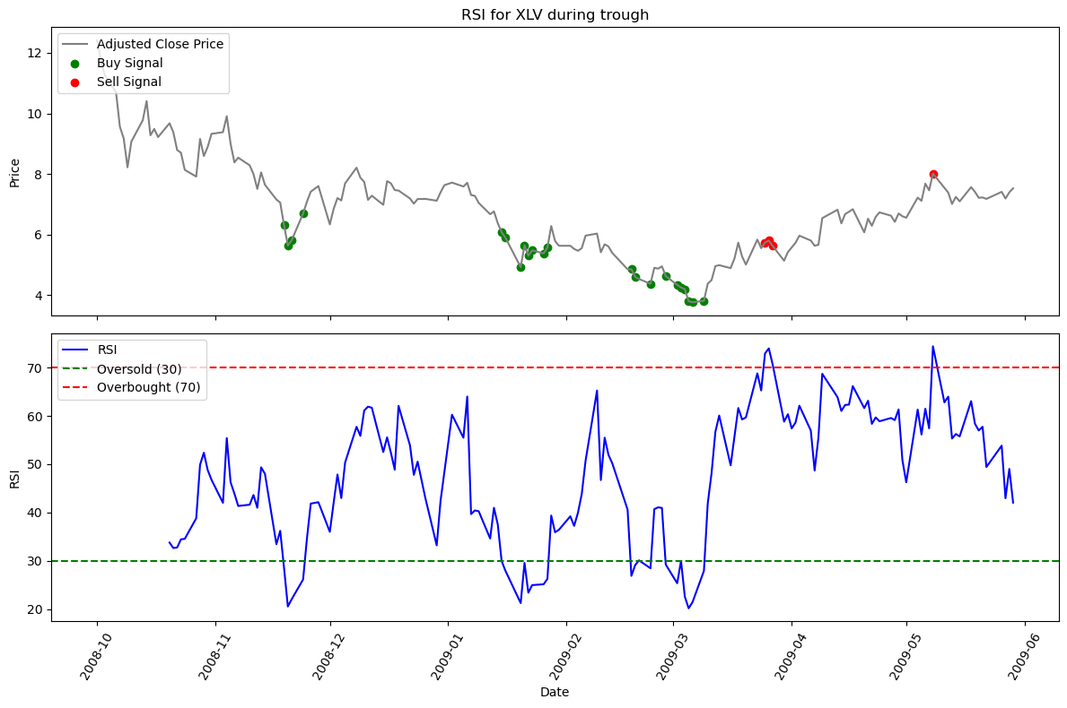
Relative Strength Index

Slide 19
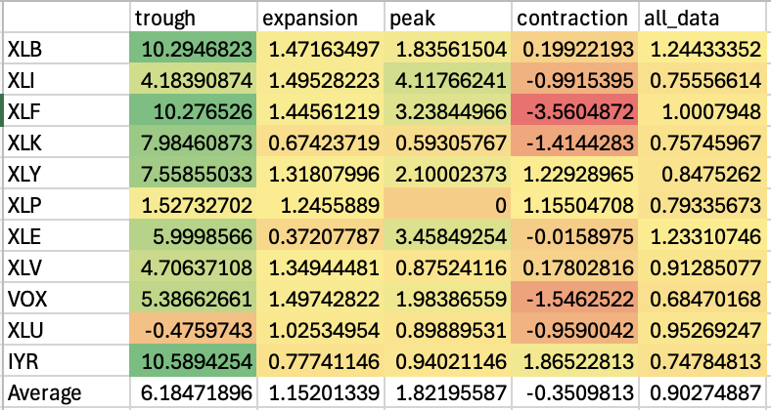
Relative Strength Index: Baseline Model Time period: 14 days

Slide 20
Relative Strength Index: Grid Search Optimized Model
The optimal seemed to be around 14 days so no change was made

Slide 21
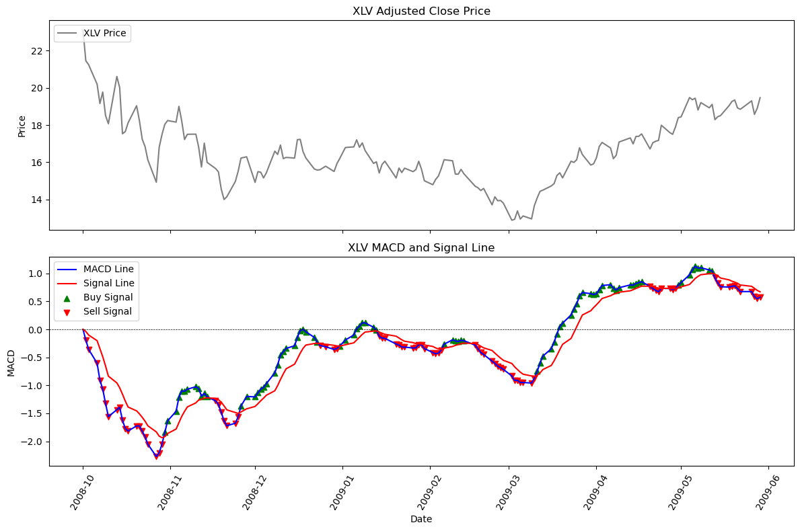
Moving Average Convergence Divergence

Slide 22
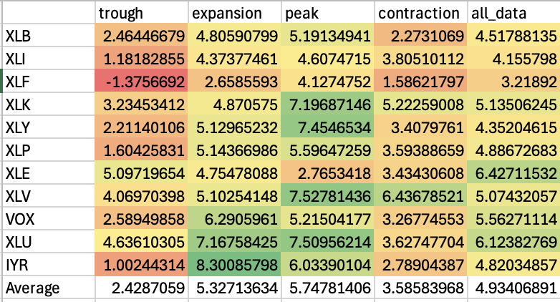
Moving Average Convergence Divergence: Baseline Model

Slide 23
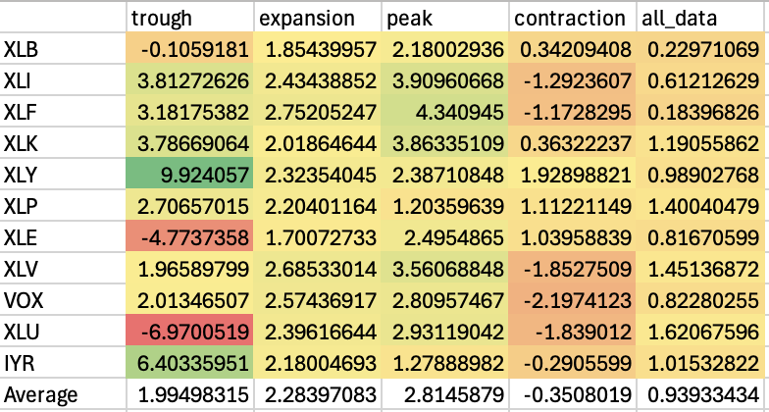
Multiple signals 'Bollinger': 0.4, 'RSI': 0.2, 'MACD': 0.4

Slide 24
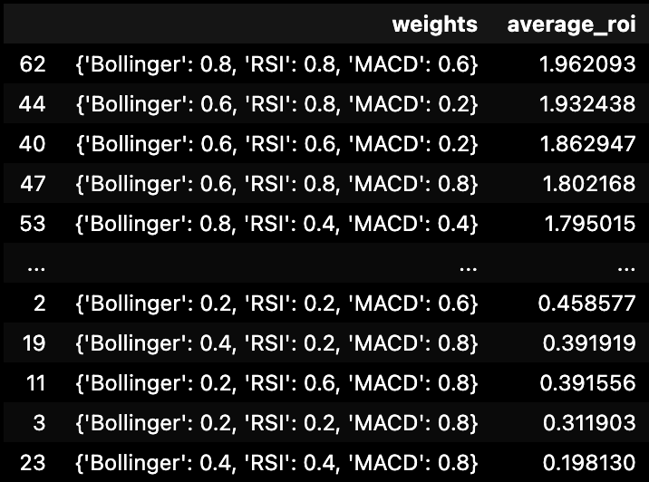
Grid search

Slide 25
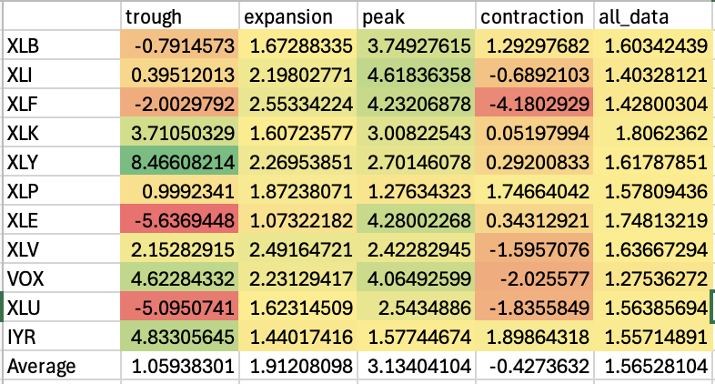
Multiple Signals Optimal 'Bollinger': 0.8, 'RSI': 0.8, 'MACD': 0.6

Slide 26
Next steps
Implement neural networks, reinforcement learning and other machine learning methods to try and create buy/sell signals.
Investigate none brute force methods to find optimal weighting given to different strategies when creating an overall model incorporating multiple models
Continue to evaluate different technical analysis techniques

